Slide 1
E6156 – Topics in SW Engineering: Cloud Computing
Lecture 5: Containers, FaaS, Events
© Donald F. Ferguson, 2022

Slide 2

Containers
2 |E6156 -- Topics Lecture 5: Containers, FaaS, Events © Donald F. Ferguson, 2021

Slide 3
Fundamental, Recurring Problem
I have one big computer and I want to run multiple applications.
This creates several challenges, e.g.
Resource sharing and allocation (CPU, memory, disk, ... ...)
Isolation: Application A should not be able to corrupt/mess with application B’s files, memory, ... ...
Configuration: Applications require libraries, versions of libraries, prerequisites, compiler/interpreter levels, ... ...
Basically, I want a way to someone package or fence all of this. We see some of the issues with Java Classpath, Python environments, ...
There are a few ways to do this:
OS process and paths.
VMs
Containers

Slide 4
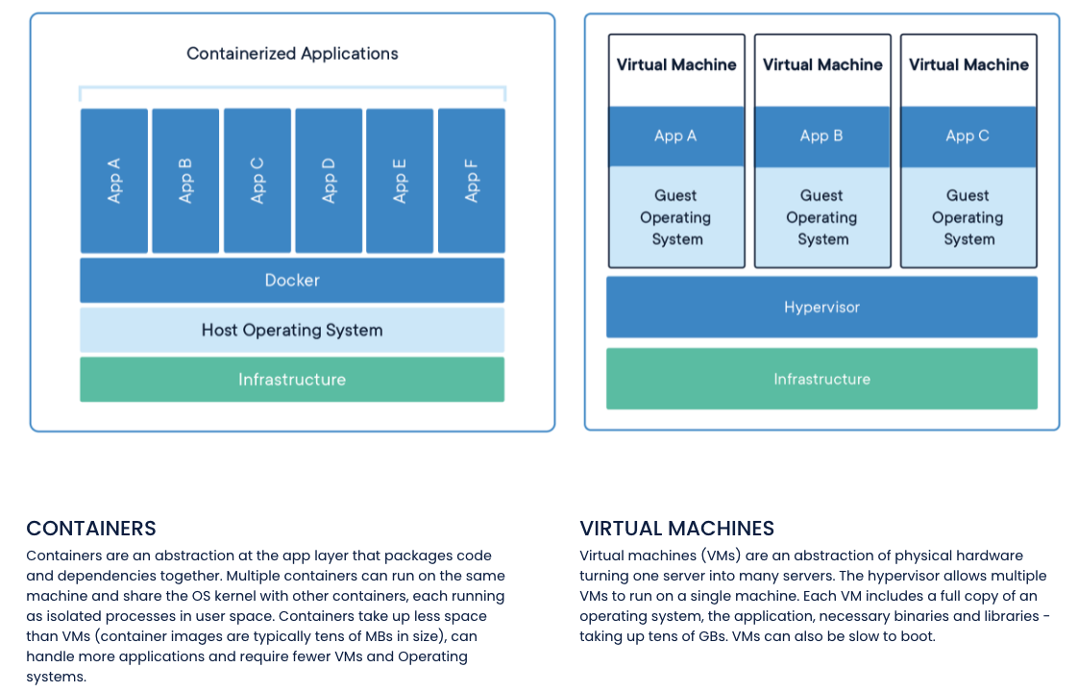
Containers and VMs

Slide 5
Concept (from Wikipedia)
“cgroups (abbreviated from control groups) is a Linux kernel feature that limits, accounts for, and isolates the resource usage (CPU, memory, disk I/O, network, etc.) of a collection of processes.”
“Namespaces are a feature of the Linux kernel that partitions kernel resources such that one set of processes sees one set of resources while another set of processes sees a different set of resources. ... ... those namespaces refer to distinct resources. Resources may exist in multiple spaces. Examples of such resources are process IDs, hostnames, user IDs, file names, and some names associated with network access, ...”

Slide 6
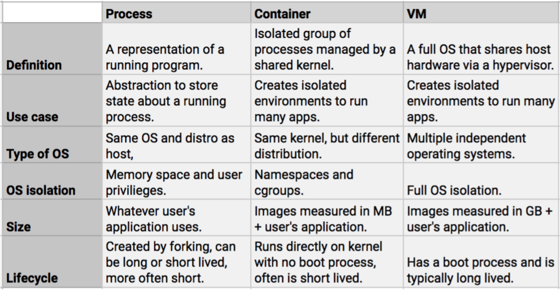
Containers vs VMs

Slide 7
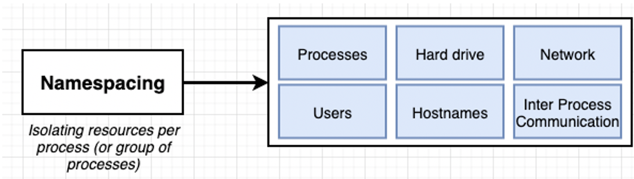
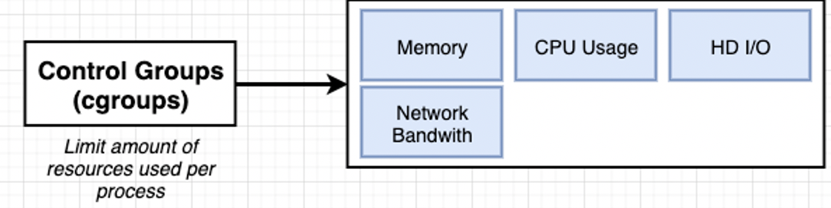
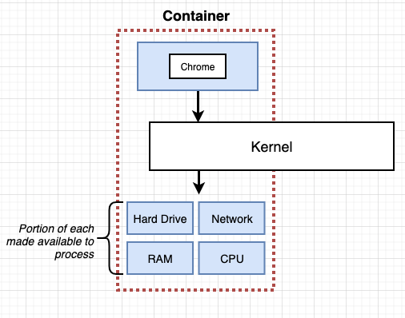
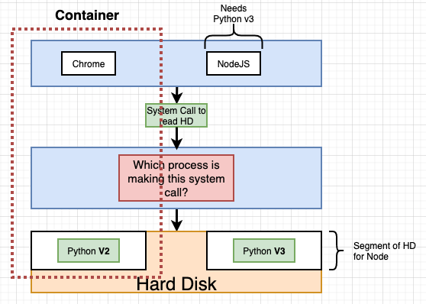
Some Container/Docker Implementation Concepts
Isolates libraries, paths, packages, PIDs, ... ...
Partitions and caps resource consumption.

Slide 8
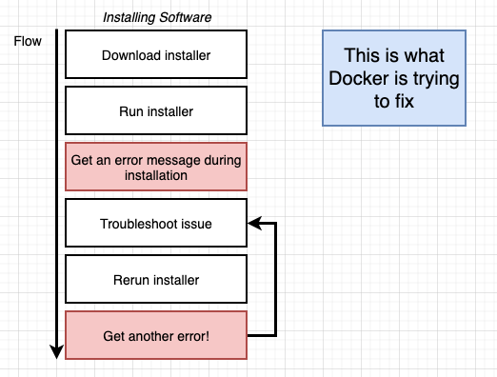
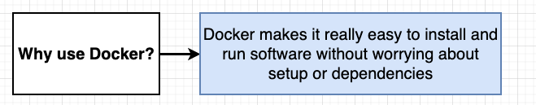
Containers and Some Docker Overview
We are familiar with the problem
We have a system with an OS and installed SW.
We need to install something new, and that requires installing prerequisites, changing versions, etc.
After many tries, we get the application installed only to find out we broke some other application.
Docker and containers allow you to:
Develop an application or SW system.
Package up the entire environment (paths, versions, libs, ...) into an image that works and is self-contained.
Someone installing/starting your application simply gets the image from a repository and starts the image to create a running container.

Slide 9
Simple Tutorial
We will follow this tutorial https://docs.docker.com/language/python/ to get experience.
But, the in the future, basic idea is the same as we have previously followed.
The steps:
Find an example of something cool.
Download it, set it up and run it.
Modify it and add my application code and logic.
Push it somewhere, in this case Docker Hub
Deploy on the cloud. AWS gives you two or three options:
Docker on EC2
Elastic Container Service
I also used this: https://www.docker.com/blog/containerized-python-development-part-2/

Slide 10
A Little More REST
10 | E6156 – Topics in SW Engineering: Lecture 5: Containers-Events © Donald F. Ferguson, 2022

Slide 11
REST Method
When your handler receives a REST operation, there are the following elements. Not all methods have all elements:
Path
Path parameters
Query string parameters
Headers
Body
The REST handler’s response has the following elements:
Status code
Body
Headers
The route handler maps between the REST representation of the elements and the language/runtime representation.
Flask provides access through the
Request object.
Response object.
Walkthrough

Slide 12
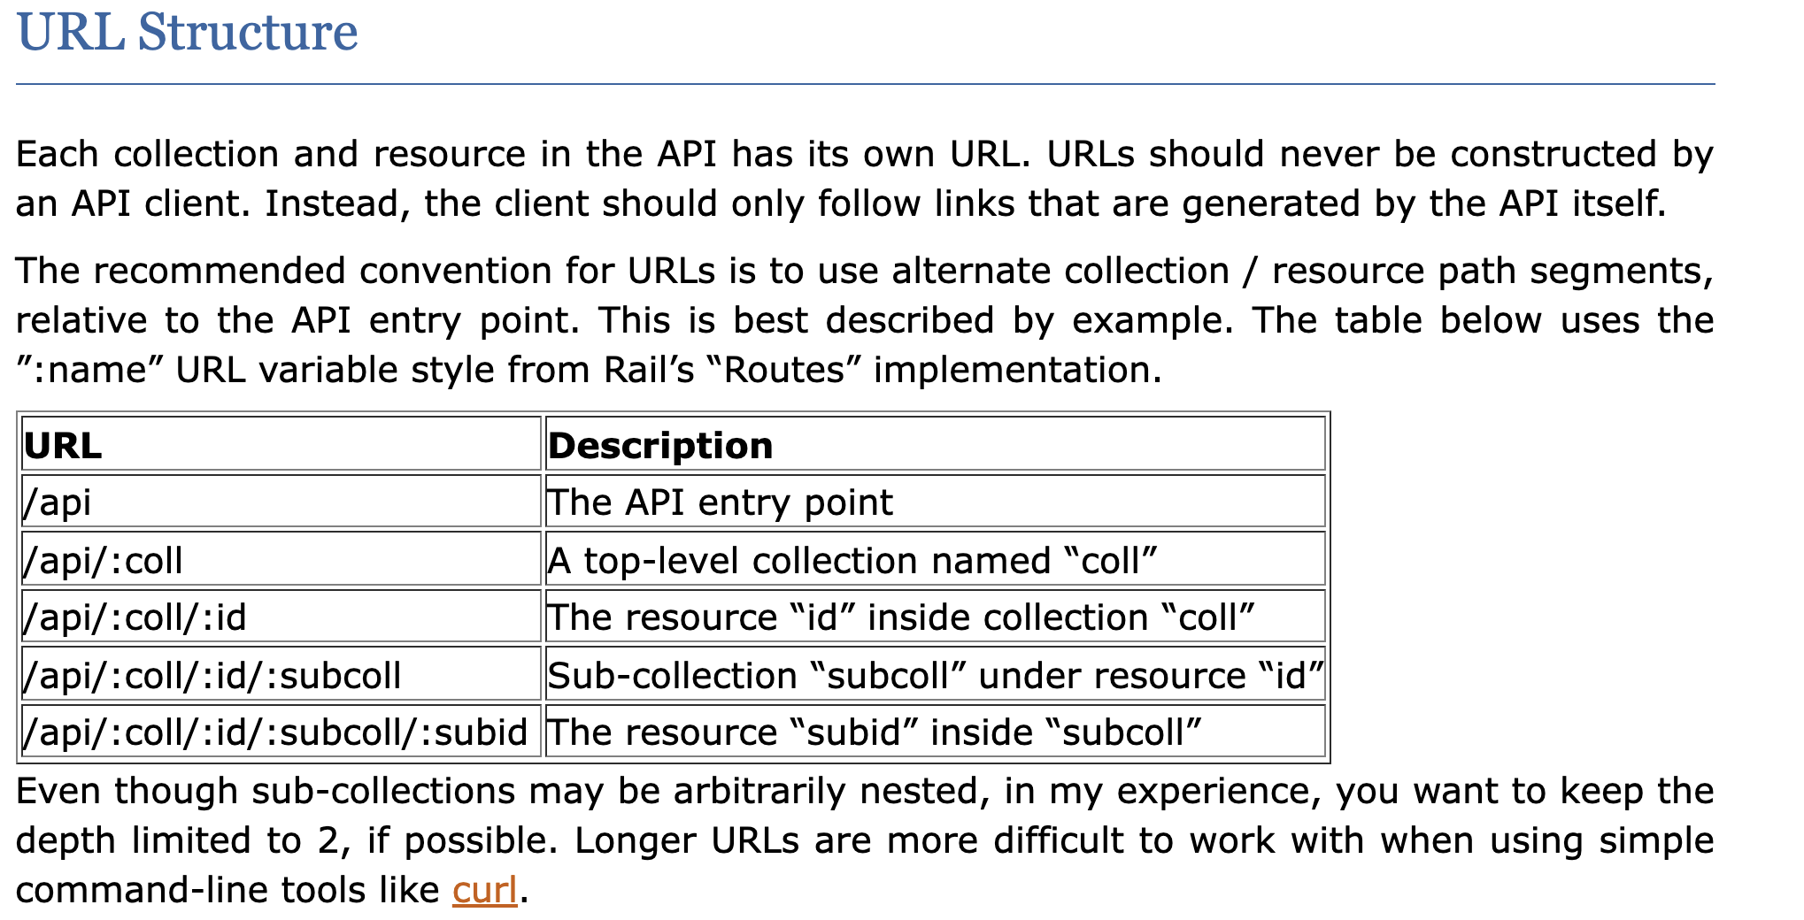
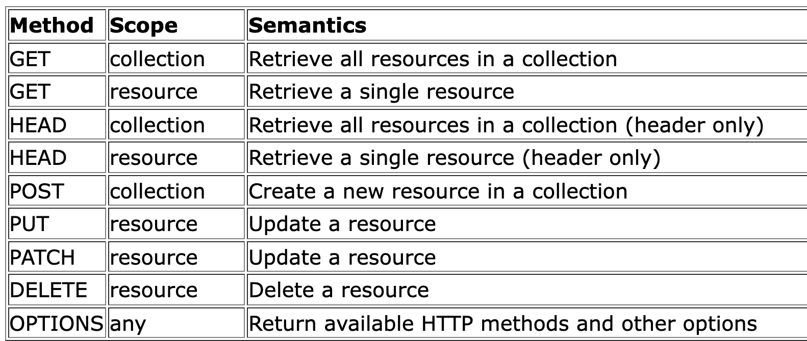
REST Paths
https://restful-api-design.readthedocs.io/en/latest/
There are many patterns. I typically follow something like:
We will not be too rigorous about status codes, but some common examples are:
200: OK (success)
201: CREATED (for POST)
404: NOT FOUND
500: INTERNAL SERVICE ERROR
418: I’M A TEAPOT

Slide 13
Success Response Codes
202 means
Your request went asynch.
The HTTP header Link is where to poll for rsp.
Operation | HTTP Request | HTTP Response Codes Supported
READ | GET | 200 - OK with message body 204 - OK no message body 206 - OK with partial message body
CREATE | POST | 201 - Resource created (Operation Complete) 202 - Resource accepted (Operation Pending)
UPDATE | PUT | 202 - Accepted (Operation Pending) 204 - Success (Operation Complete)
DELETE | DELETE | 202 - Accepted (Operation Pending) 204 - Success (Operation Complete)
Examples of Link Headers in HTTP response:
Link: <http://api/jobs/j1>;rel=monitor;title="update profile"
Link: <http://api/reports/r1>;rel=summary;title=”access report”

Slide 14
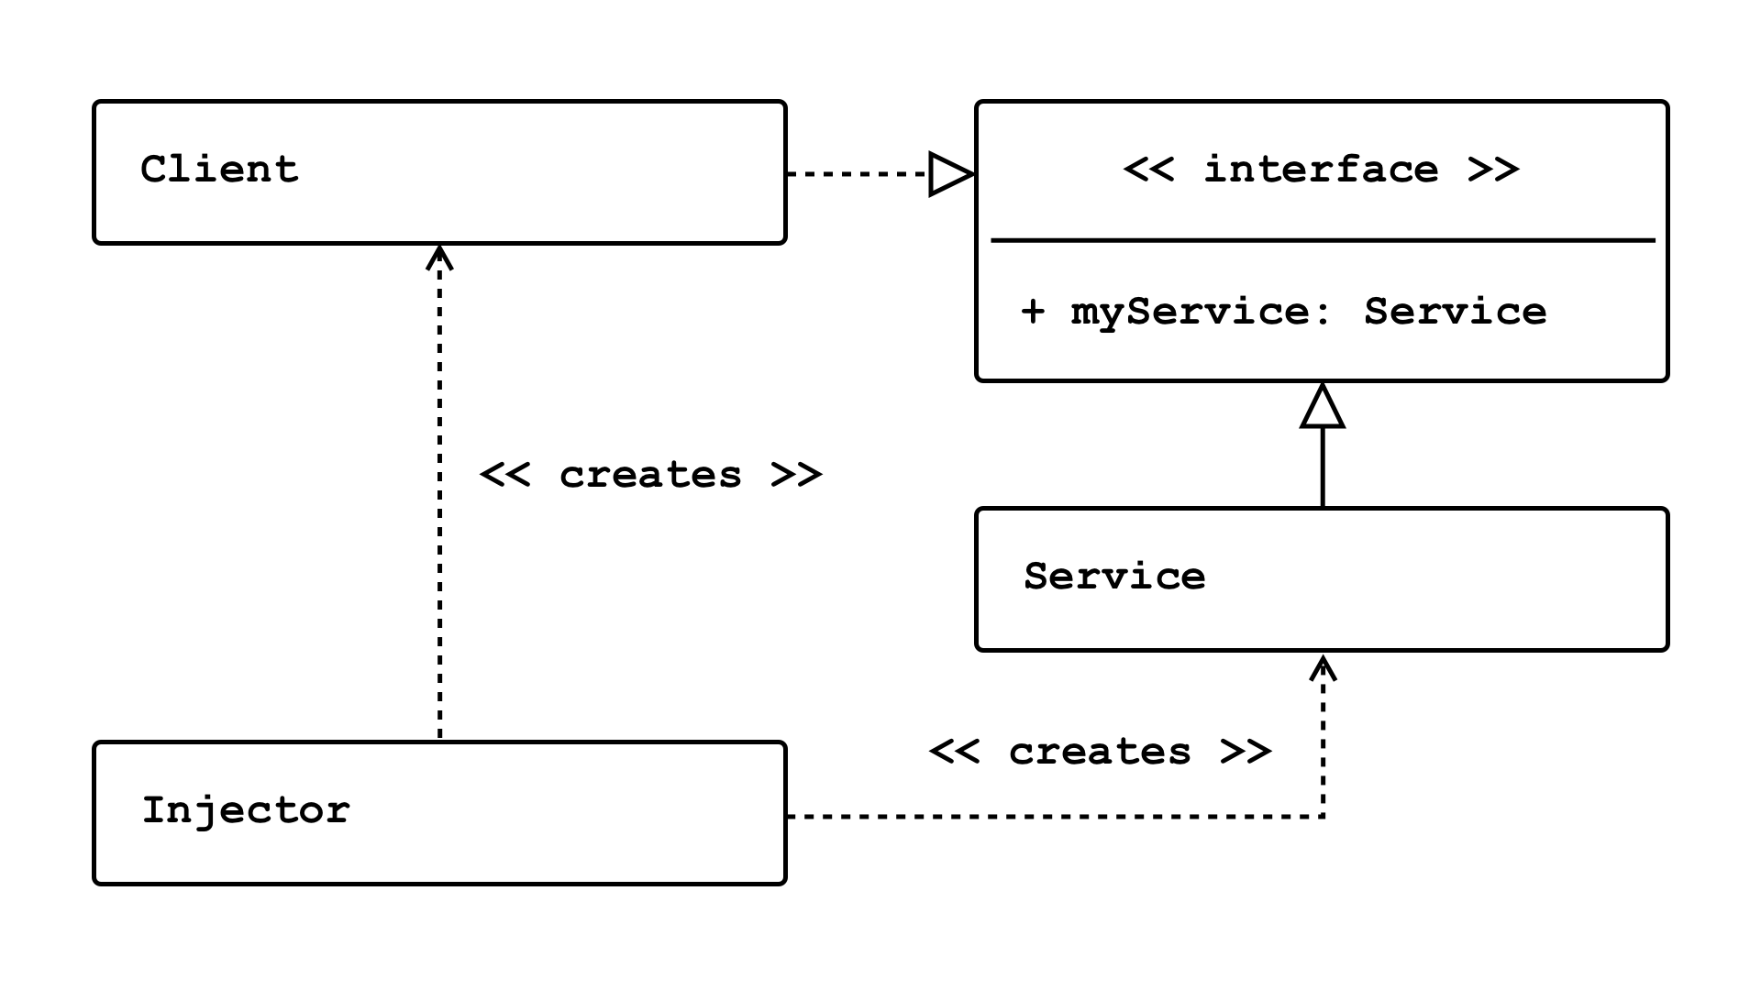
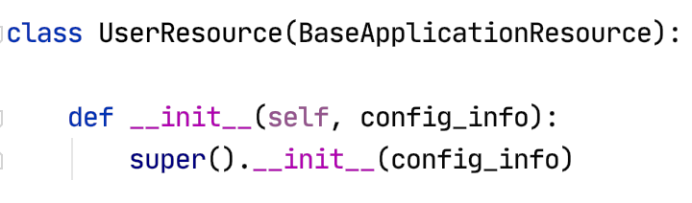
Dependency Injection
Concepts (https://en.wikipedia.org/wiki/Dependency_injection):
In software engineering, dependency injection is a technique in which an object receives other objects that it depends on, called dependencies.
The intent behind dependency injection is to achieve separation of concerns of construction and use of objects. This can increase readability and code reuse.
There is no single approach. There are several frameworks, tools, etc.
Like many other things, it is easy to get carried away and become dogmatic.
I follow a single approach:
A Context class converts environment and other configuration and provides to application.
The top-level application injects a config_info object into services.

Slide 15
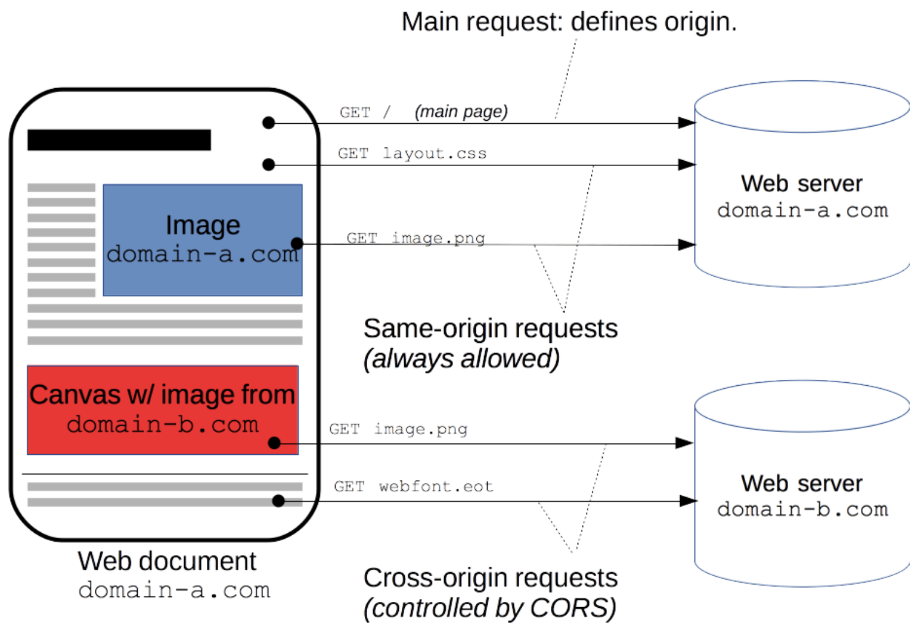
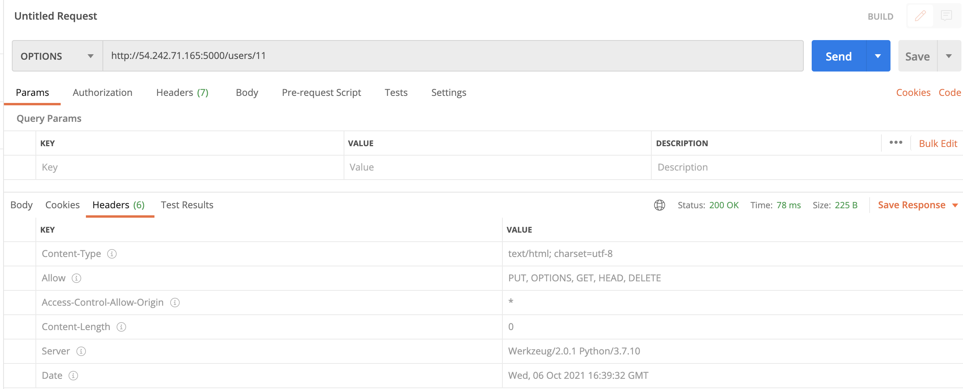
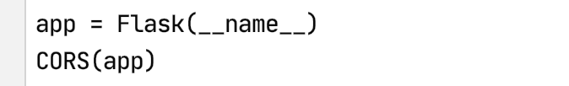
CORS
https://developer.mozilla.org/en-US/docs/Web/HTTP/CORS
“For security reasons, browsers restrict cross-origin HTTP requests initiated from scripts. For example, XMLHttpRequest and the Fetch API follow the same-origin policy. This means that a web application using those APIs can only request resources from the same origin the application was loaded from unless the response from other origins includes the right CORS headers.”

Slide 16
REST Principles HATEOAS
16 | E6156 – Topics in SW Engineering: Lecture 4: APIs, REST, SSO, Events © Donald F. Ferguson, 2022

Slide 17
REST Principles
REST Principles:
Uniform interface
Client–server
Stateless
Cacheable
Layered system
Code on demand (optional)
Many of these are straightforward. We will explore some of the concepts in various lectures.
Today, we cover “statelessness.”
HATEOAS: Hypertext as the Engine of Application State --
The principle is that a client interacts with a network application entirely through hypermedia provided dynamically by application servers. A REST client needs no prior knowledge about how to interact with any particular application or server beyond a generic understanding of hypermedia.

Slide 18
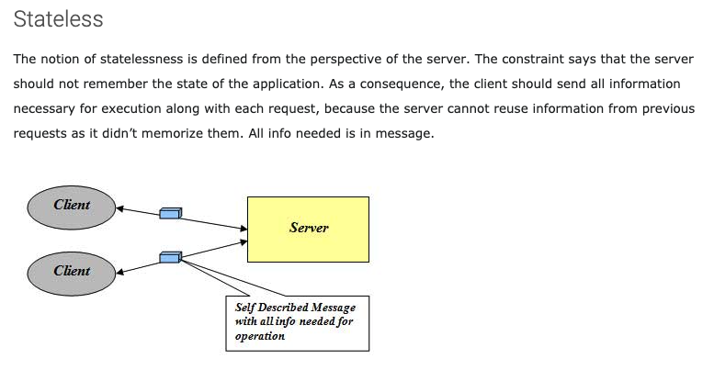
Stateless
http://mrbool.com/rest-architectural-elements-and-constraints/29339

Slide 19
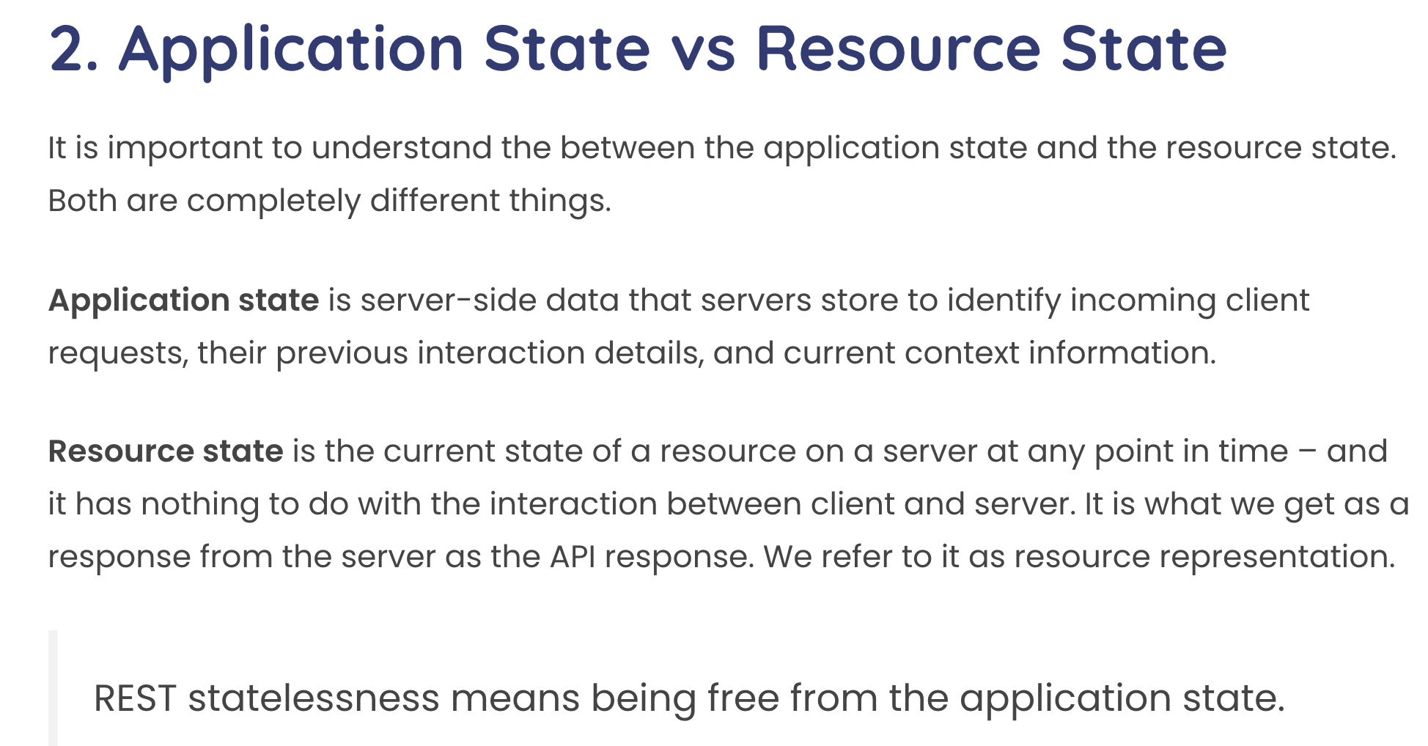
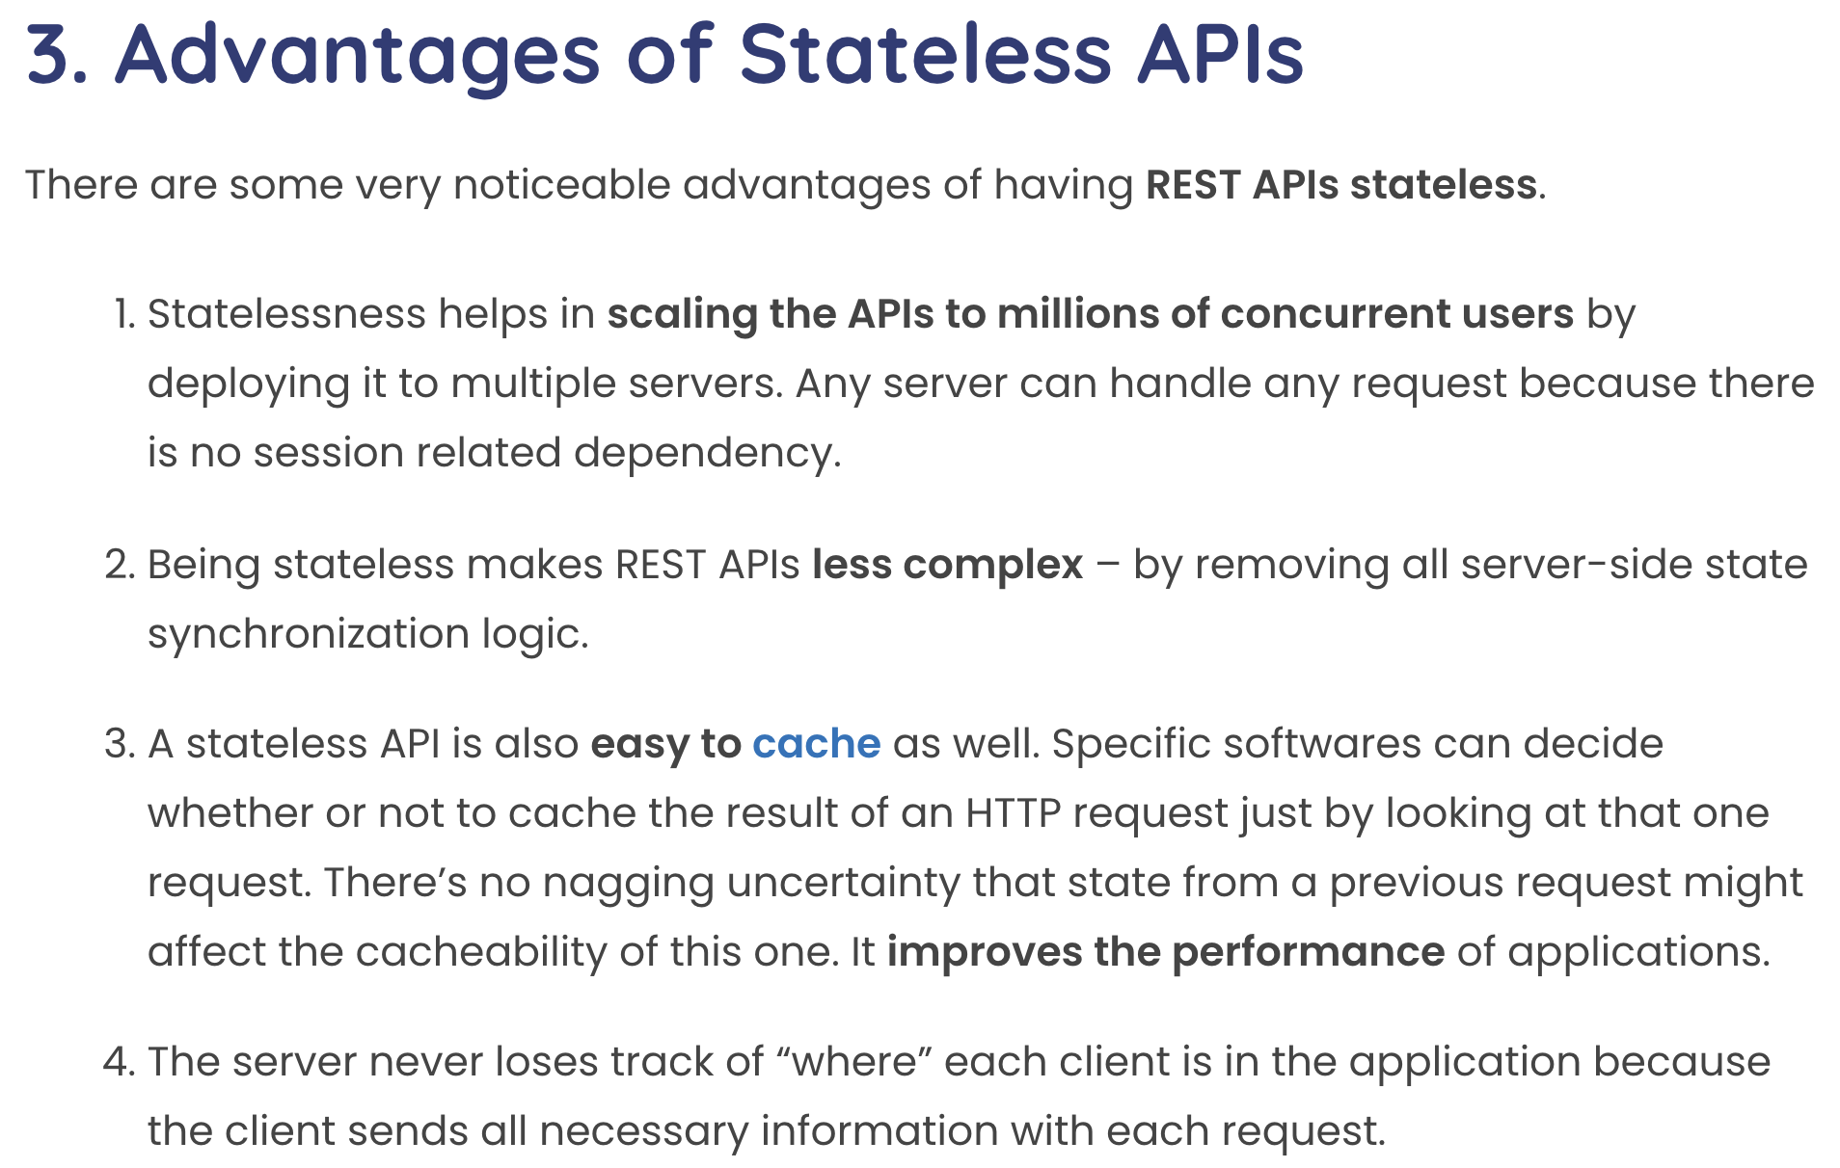
Statelessness
This concept can be confusing with experience with other approach to session state.
Some application frameworks did/do keep session state on the server.
Application servers and frameworks have various support for “session state,” e.g. https://flask-session.readthedocs.io/en/latest/

Slide 20
Middleware
20 | E6156 – Topics in SW Engineering: Lecture 5: APIs, Lambda, SSO, Events © Donald F. Ferguson, 2022

Slide 21
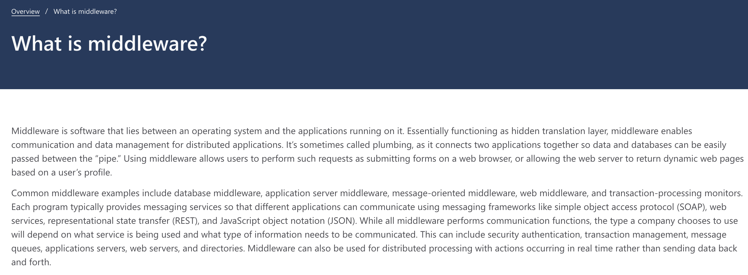
Middleware

Slide 22
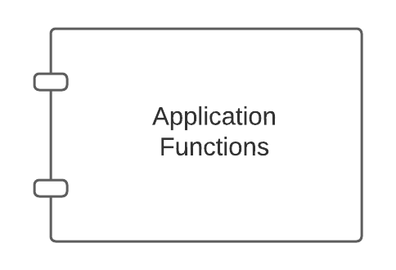
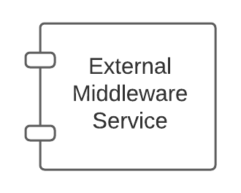
Middleware – Conceptual Model
There are app server specific approaches to injecting into the applications.

Slide 23
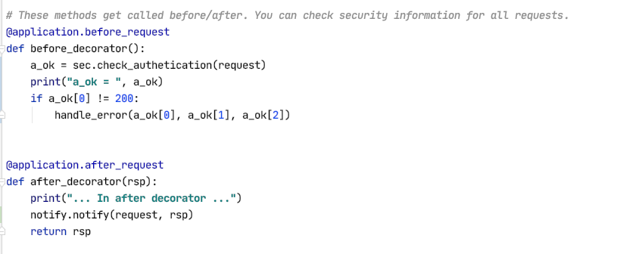
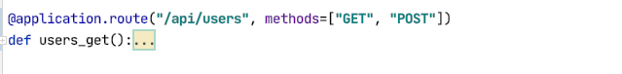
Middleware and Flask
White list of URLs
If not on white list:
Verify token
Verify authorization
List of filters of the form:
URL
HTTP Method
SNS topic to use
Send an event to SNS if matches filter
Show some demo code.

Slide 24
So, How Will We Use This?
Add before_request and after_request to microservices. (Note: There are other approaches).
Implement two middleware interceptors:
Security
Configured with a JSON file.
File lists which {path, method} require being logged on.
While IDs can perform which methods on which paths.
Automates driving login redirect (401 – Unauthorized)
Checks authorization (403– Forbidden)
Notification:
Configured with JSON file.
File lists which operations emit a before and/or after event to an SNS topic.
We will use notification to drive some other things like webhooks.

Slide 25
Event Drive Processing Publish/Subscribe
25 | E6156 – Topics in SW Engineering: Lecture 5: APIs, Lambda, SSO, Events © Donald F. Ferguson, 2022

Slide 26
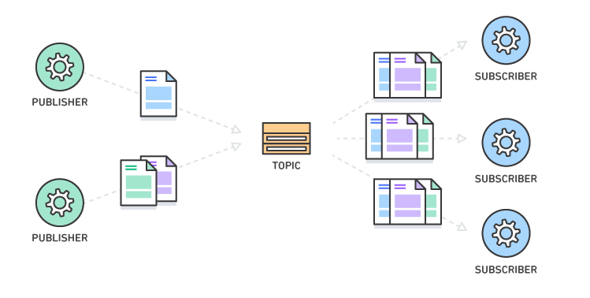
Pub/Sub – Event Driven Processing
“In software architecture, publish–subscribe is a messaging pattern where senders of messages, called publishers, do not program the messages to be sent directly to specific receivers, called subscribers, but instead categorize published messages into classes without knowledge of which subscribers, if any, there may be. Similarly, subscribers express interest in one or more classes and only receive messages that are of interest, without knowledge of which publishers, if any, there are.
Publish–subscribe is a sibling of the message queue paradigm, and is typically one part of a larger message-oriented middleware system. Most messaging systems support both the pub/sub and message queue models in their API, e.g. Java Message Service (JMS).
This pattern provides greater network scalability and a more dynamic network topology, with a resulting decreased flexibility to modify the publisher and the structure of the published data.”
It also support loose coupling for application evolution and agility.
I can add and evolve services without modifying the services.
https://en.wikipedia.org/wiki/Publish%E2%80%93subscribe_pattern

Slide 27
Pub/Sub – Simple Notification Service
27 | E6156: Topics in SW Engineering – Cloud Computing/BaaS

Slide 28
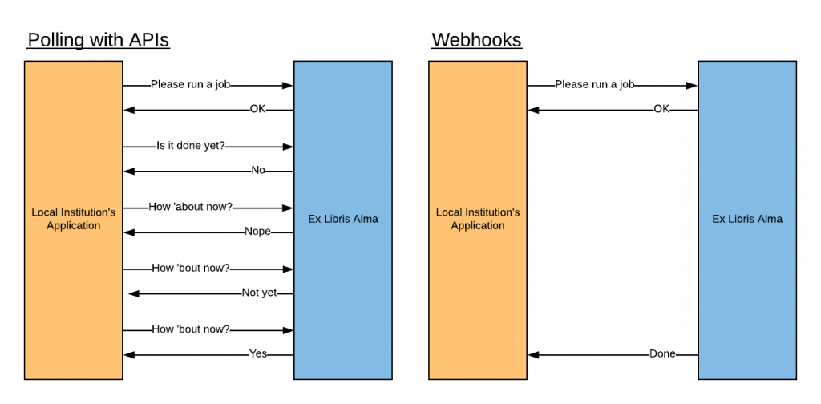
Webhooks
“A webhook in web development is a method of augmenting or altering the behavior of a web page or web application with custom callbacks. These callbacks may be maintained, modified, and managed by third-party users and developers who may not necessarily be affiliated with the originating website or application. The term "webhook" was coined by Jeff Lindsay in 2007 from the computer programming term hook.”

Slide 29
Function-as-a-Service
29 | E6156 – Topics in SW Engineering: Lecture 5: APIs, Lambda, SSO, Events © Donald F. Ferguson, 2022

Slide 30
Serverless and Function-as-a-Service
Serverless computing is a cloud computing execution model in which the cloud provider runs the server, and dynamically manages the allocation of machine resources. Pricing is based on the actual amount of resources consumed by an application, rather than on pre-purchased units of capacity.^{[1]} It can be a form of utility computing. Serverless computing can simplify the process of deploying code into production. Scaling, capacity planning and maintenance operations may be hidden from the developer or operator. Serverless code can be used in conjunction with code deployed in traditional styles, such as microservices. Alternatively, applications can be written to be purely serverless and use no provisioned servers at all.^{[2]} This should not be confused with computing or networking models that do not require an actual server to function, such as peer-to-peer (P2P).”
Function as a service (FaaS) is a category of cloud computing services that provides a platform allowing customers to develop, run, and manage application functionalities without the complexity of building and maintaining the infrastructure typically associated with developing and launching an app.^{[1]} Building an application following this model is one way of achieving a "serverless" architecture, and is typically used when building microservices applications.”
That was baffling:
IaaS, CaaS – You control the SW stack and the cloud provides (virtual) HW.
PaaS – The cloud hides the lower layer SW and provides an application container (e.g. Flask) with “Your code goes here.” You are aware of container.
FaaS – The cloud provides the container, and you implement functions (corresponding to routes in REST).

Slide 31
Serverless and Function-as-a-Service
https://medium.com/@tanmayct/serverless-architecture-function-as-a-service-19e127b8c990

Slide 32









What is Serverless Good/Not Good For ... ...
Serverless is good for
short-running
stateless
event-driven
Serverless is not good for
long-running
stateful
number crunching
Microservices
Databases
Mobile Backends
Deep Learning Training
Bots, ML Inferencing
Heavy-Duty Stream Analytics
IoT
f(x)
Numerical Simulation
Modest Stream Processing
Video Streaming
Service integration

Slide 33

What triggers code execution?
Runs code in response to events
Event-programming model
Notes:
What is Serverless

Slide 34



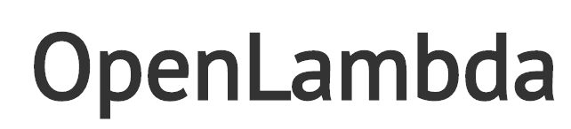



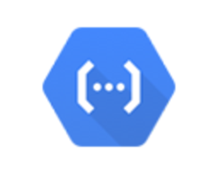



(Some) Current Platforms for Serverless
AWS Lambda
Azure Functions
Kubernetes
IBM Cloud Functions
Red-Hat
Google Functions
Notes:
Auth0, Twitter, ..
And many more upcoming / open source

